Slide 1

Welcome to the
All Together Catechism

Slide 2

Part A
Sovereign Creator

Slide 3
Question A1
Who is the
one true God?

Slide 4
Answer A1
God is the maker and ruler of everyone and everything.

Slide 5
Question A2
Why did God make everyone and everything?

Slide 6
Answer A2
God made all things for his glory.

Slide 7
Question A3
Who are we?

Slide 8
Answer A3
We are made body and soul, male and female, in God’s image.

Slide 9
Question A4
What does it mean to be made in God’s image?

Slide 10
Answer A4
We are made to worship God,
and rule creation rightly.

Slide 11
Question A5
What does God teach by first making one man and one woman?

Slide 12
Answer A5
That marriage joins one man
and one woman for life.

Slide 13

Part B
Law Giver

Slide 14
Question B1
How can we bring God glory?

Slide 15
Answer B1
By enjoying him and obeying
all that he commands.

Slide 16
Question B2
What does God command?

Slide 17
Answer B2
We must always love God and love each other.

Slide 18
Question B3
How are we to love God?

Slide 19
Answer B3
We must trust and treasure God more than all he has made.

Slide 20
Question B4
How are we to love each other?

Slide 21
Answer B4
We must be humble and kind to our families and friends and even our enemies.

Slide 22
Question B5
How are we
to love our families?

Slide 23
Answer B5
Men must lovingly lead their wives and children, and children must obey their parents.

Slide 24

Part C
Righteous Judge

Slide 25
Question C1
Does anybody keep God’s commands?

Slide 26
Answer C1
No. Our first parents sinned, and now all are born into sin and guilt.

Slide 27
Question C2
What is sin?

Slide 28
Answer C2
Sin is disobeying what God has commanded.

Slide 29
Question C3
What was God’s response to sin?

Slide 30
Answer C3
God cursed his creation with sadness and death.

Slide 31
Question C4
Why do we continue to sin?

Slide 32
Answer C4
Our souls are
sick and do not trust that God
is good.

Slide 33
Question C5
If we cannot keep God’s commands, what use are they?

Slide 34
Answer C5
They teach us about God,
about our sin,
and that we need a saviour.

Slide 35

Part D
Incarnate Son

Slide 36
Question D1
Is there a saviour for us?

Slide 37
Answer D1
Yes.
Our promised saviour is the Lord Jesus Christ.

Slide 38
Question D2
How did our saviour Jesus Christ come into the world?

Slide 39
Answer D2
By the Holy Spirit, born of the Virgin Mary, full of grace and truth.

Slide 40
Question D3
What does it mean that Christ was born of woman and by the Spirit?

Slide 41
Answer D3
Jesus Christ is God the Son: he is fully man and fully God.

Slide 42
Question D4
How can it be that Christ is God, since there is only one true God?

Slide 43
Answer D4
There are three persons in one God: Father, Son, and Holy Spirit.

Slide 44
Question D5
Why is it so important that Christ is both God and man?

Slide 45
Answer D5
So he could fully defeat sin and death, and represent us before the Father.

Slide 46
Question D6
How then should we pray?

Slide 47
Answer D6
We pray humbly
to our Father, confident in Christ, and persistent in the Spirit.

Slide 48

Part E
Servant King

Slide 49
Question E1
What does it mean that
Jesus is called the Christ?

Slide 50
Answer E1
Jesus is the Spirit-filled King, who taught with authority, and who suffered in sacrifice.

Slide 51
Question E2
How did Jesus show he was the Spirit-filled King?

Slide 52
Answer E2
Jesus showed his authority over nature, the devil, and even death.

Slide 53
Question E3
How can we know the teaching of Christ?

Slide 54
Answer E3
The Bible teaches us all we need to know about Christ and how to be his disciples.

Slide 55
Question E4
In what way did Christ suffer?

Slide 56
Answer E4
Christ was judged unfairly, crucified to death shamefully, and was buried.

Slide 57
Question E5
In what way was Christ’s death a sacrifice?

Slide 58
Answer E5
Christ bore God’s anger against sin, in the place of sinners.

Slide 59

Part F
Gracious Saviour

Slide 60
Question F1
Are all people saved from their sin because of what Christ has done?

Slide 61
Answer F1
No. Only those with true repentance
and faith.

Slide 62
Question F2
What is true repentance that saves?

Slide 63
Answer F2
Hating our sin and turning away from it.

Slide 64
Question F3
What is true
faith that saves?

Slide 65
Answer F3
Completely trusting in Christ as our saviour and greatest treasure.

Slide 66
Question F4
Does this mean that being saved is something we do ourselves?

Slide 67
Answer F4
Only by grace, through the Spirit, can we repent
and have faith.

Slide 68
Question F5
What is the work of the Spirit to save us?

Slide 69
Answer F5
The Spirit makes us one with Christ, so we are his
and he is ours.

Slide 70

Part G
Risen Champion

Slide 71
Question G1
What does it mean to be made one with Christ?

Slide 72
Answer G1
He takes our sin, and we are adopted, justified, and sanctified.

Slide 73
Question G2
How can we be one with Christ, since he died?

Slide 74
Answer G2
On the third day, Christ rose from the dead in new resurrected life.

Slide 75
Question G3
What does it mean to be adopted?

Slide 76
Answer G3
God takes us to
be his own beloved children, like Christ is.

Slide 77
Question G4
What does it mean to be justified?

Slide 78
Answer G4
Even though
we are sinners,
God declares us righteous,
like Christ is.

Slide 79
Question G5
What does it mean to be sanctified?

Slide 80
Answer G5
God changes our hearts so we can grow more and more like Christ.

Slide 81
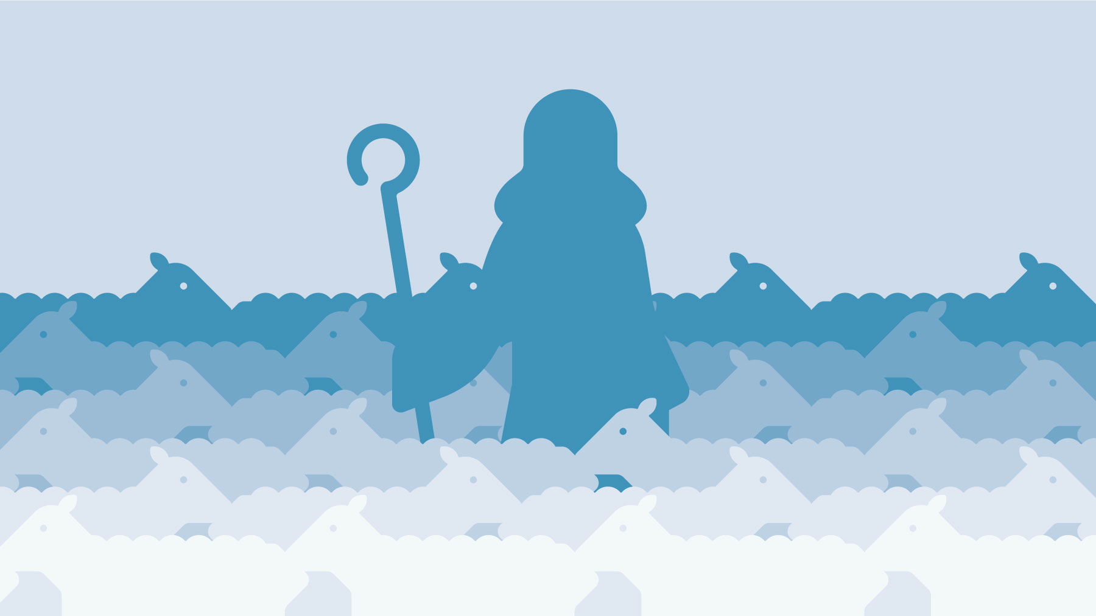
Part H
Faithful Shepherd

Slide 82
Question H1
Where is
Christ now?

Slide 83
Answer H1
He rose to heaven, where he speaks for us, and rules his Church.

Slide 84
Question H2
What is a church?

Slide 85
Answer H2
A gathered community of Christ’s disciples, fed and protected by him.

Slide 86
Question H3
How does Christ feed and protect his Church?

Slide 87
Answer H3
By his Spirit speaking through the Bible, the Lord’s supper, and baptism.

Slide 88
Question H4
How should a church gather?

Slide 89
Answer H4
Faithfully and prayerfully,
to hear the
Bible preached,
and to encourage
each other.

Slide 90
Question H5
Who does Christ use to help him feed and protect his church?

Slide 91
Answer H5
Christ gives pastors, who must gently and humbly teach and guard each church.

Slide 92
alltogethercatechism.co.uk

